Slide 1
AN ADVANCED AMBULANCE RESCUE SYSTEM USING PRIORITIZED TRAFFIC SWITCHING

Slide 2
ABSTRACT:
There is loss of life as a result of the delay within the arrival of ambulance to the hospital within the golden hour. This delay is especially caused by the waiting of the ambulance within the traffic signals.
The ambulance is controlled by the control unit that furnishes adequate route to the ambulance and conjointly controls the stoplight in step with the ambulance location and therefore reaching the hospital safely.
The controller identifies the situation of the accident spot through the measuring system within the vehicle and therefore the controller walks through the ambulance to the spot.
This theme is totally ambulance -controlled, therefore it finds the accident spot, controls the traffic lights, serving to succeed in the hospital in time.

Slide 3
LITERATURE SURVEY 1
S.NO | TITLE | NAME | YEAR | REMARKS
1 | Traffic accident Automatic detection and remote alarm Device | Shradha Somani , Parikshit Solunke , Shaunak Oke , Parth Medhi | 2018 | This project focuses on building a home security system which will be wireless. Security over a network is achieved using AES encryption. Security of house is managed by sending notifications to the user using Internet in case of any trespasser and it can also ring an alarm if required. Home automation is utilized by using appropriate sensors installed around house. Raspberry pi is used as a server and controller. Raspberry pi has task of controlling electrical appliances and providing authentication and security to user.

Slide 4
LITERATURE SURVEY 2
S.NO | TITLE | NAME | YEAR | REMARKS
2 | A Smart Home Automation and Metering System using Internet of Things (IoT) | Sadi Mahmud , Safayet Ahmed , Kawshik Shikder , American International UniversityBangladesh Dhaka, Bangladesh | 2019 | This paper discussed a smart low-cost home automation system which is designed using IoT. With the help of this system, all the home appliances and electronic machines can be controlled and observed through a website very easily. The metering method of a home can also be supervised using this system. Not only the consumers but also the dealers will get the opportunity to observe the anomalies of the power distribution system by watching the metering system. Online billing system also included in the designed system.

Slide 5
LITERATURE SURVEY 3
S.NO | TITLE | NAME | YEAR | REMARKS
3 | Mobile based Home Automation using Internet of Things(IoT) | Kumar Mandula, Ramu Parupalli, CH.A.S.Murty, E.Magesh, Rutul Lunagariya | 2018 | This paper discusses about loT and how it can be used for realizing smart horne automation using a micro-controller based Arduino board and Android mobile app. In this paper, two prototypes namely horne automation using Bluetooth in an indoor environment and horne automation using Ethernet in an outdoor environment are presented

Slide 6
LITERATURE SURVEY 3
S.NO | TITLE | NAME | YEAR | REMARKS
4 | An IoT-Based Home Automation System Using Wi-Fi Wireless Sensor Networks | Chwan-Lu Tseng ; Che-Shen Cheng ; Yu-Hsien Hsu ; Bing-Hung Yang | 2018 | With the Chatbot API, this paper proposes an IoT-based home automation system. The Chatbot simplifies the user interface and allows users being able to control each device at home by way of chatting with Chatbot. To build up the system, the Line messaging API is adopted to conduct smart home applications. After the user interacts with Chatbot, Line Server transmits the conversation message to the back-end analysis platform through HTTPS secure transmission. Once the platform analyzes the messages and makes relevant decisions, control messages will be transmitted to the central control board through MQTT communication to control various appliances at home.

Slide 7
LITERATURE SURVEY 3
S.NO | TITLE | NAME | YEAR | REMARKS
5 | Home Automation Using Energy Usage | Avirup Basu ; Abhishek Nandy ; Manisha Biswas ; Raja Nand Sharma ; Risab Biswas | 2018 | Home automation is usually referred to the technique for controlling devices autonomously based on certain parameters. However, most of the system that exist is more of remote control rather than home automation. In this research paper, we're presenting a model for automating homes based on energy usage as the primary parameter. The autonomous control based on primary parameters are based on the application of machine learning using artificial neural network(s). The model is essentially a recommendation system and presents the user with alerts or recommendation. Remote control and monitoring act as the base of the system and two architecture(s) are presented to attain the same.

Slide 8
EXISTING SYSTEM:
In previous system there is no technology for accident detection. As it is done manually, there is loss of life in golden hours.
The accident victim is dependent on the mercy of others to rush him to hospital. Many times accident goes unnoticed for hours before help comes in.
Due to all these factors there is high rate of mortality of accident victims.
In addition to this there is a delay in the ambulance reaching the hospital due to the traffic congestion between accident location and hospital which increases the chances of death of victim.

Slide 9
PROPOSED SYSTEM:
In order to overcome the existing problem we implement a new system in which there is an automatic detection of accident.
A GSM, GPS, Accelerometer unit fitted in the vehicle detects the accident and sends the accident location.
The main server unit and ambulance is rushed into accident spot which carries the patient to hospital and along with this controlling the traffic lights signals.
In the path of the ambulance to provide the clear path. This will minimize the time required to by the ambulance to reach the hospital.

Slide 10
BLOCK DIAGRAM
POWER SUPPLY
ARDUINO UNO
MEMS SENSOR
GSM
GPS
ZIGBEE TX

Slide 11
BLOCK DIAGRAM
POWER SUPPLY
ARDUINO UNO
ZIGBEE RX
LCD DISPLAY
LED ARRAY
MOTOR 1
MOTOR DRIVER
MOTOR 2

Slide 12
HARDWARE REQUIREMENTS:
Arduino uno
Mems sensor
Vibration sensor
GPS
Buzzer
SOFTWARE REQUIREMENTS:
Arduino IDE
Embedded C

Slide 13
ARDUINO UNO
The Arduino Uno is a microcontroller board grounded on the ATmega328 (datasheet). It comprises of 14 digital input/output pins (out of which 6 can be utilized as PWM outputs), 6 analog inputs, a 16 MHz ceramic resonator, a facilitation for USB connectivity, a power jack, an ICSP header, and a reset button. Its designs comprises of assistances that supports the microcontroller in every possible way.
In order to get to work with it one has to simply connect it to a computer with a USB cable or power it with an AC-to-DC adapter or battery. It is accessible in two different versions namely Arduino Uno and Genuino Uno which could be The variations is observed with reference to the region.

Slide 14
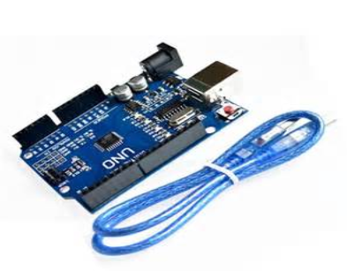
SPECIFICATION
ATmega328-AU microcontroller with UNO Bootloader Installed.
USB Programming Facilitated by the CH340G.
USB-B Connector and cable included.
Input voltage - 7-15V.
0-5V outputs with 3.3V compatible inputs.
14 Digital I/O Pins (6 PWM outputs).
6 Analog Inputs.
ISP Header.
32k Flash Memory
16MHz Clock Speed.

Slide 15
GSM SIM900
The GSM shield by Arduino is used to send/ receive messages and make/receive calls just like a mobile phone by using a SIM card by a network provider.
We can do this by plugging the GSM shield into the Arduino board and then plugging in a SIM card from an operator that offers GPRS coverage.
The shield employs the use of a radio modem by SIMComm.
We can communicate easily with the shield using the AT commands. The GSM library contains many methods of communication with the shield.
This GSM Modem can work with any GSM network operator SIM card just like a mobile phone with its own unique phone number.
Advantage of using this modem will be that its RS232 port can be used to communicate and develop embedded applications.
Applications like SMS Control, data transfer, remote control and logging can be developed easily using this.

Slide 16
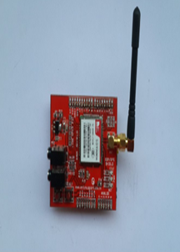
FEATURES
Dual-Band 900/ 1800 MHz
GPRS multi-slot class 10/8
GPRS mobile station class B
Compliant to GSM phase 2/2+
Class 4 (2 W @900 MHz)
Class 1 (1 W @ 1800MHz)
Dimensions: 24*24*3 mm
Supply voltage range: 3.1- 4.8V
Low power consumption: 1.5mA(sleep mode)
Operation temperature: -40° C to +85°C

Slide 17
SOFTWARE REQUIEMENTS
EMBEDDED C
ARDUINO IDE

Slide 18
ARDUINO IDE
Arduino is an open-source platform used for building electronics projects.
Arduino consists of both a physical programmable circuit board (often referred to as a microcontroller) and a piece of software, or IDE (Integrated Development Environment) that runs on your computer, used to write and upload computer code to the physical board.
The Arduino platform has become quite popular with people just starting out with electronics, and for good reason.

Slide 19
CONT.,
This flexibility combined with the fact that the Arduino software is free, the hardware boards are pretty cheap, and both the software and hardware are easy to learn has led to a large community of users who have contributed code and released instructions for a huge variety of Arduino-based projects.
There are many varieties of Arduino boards (explained on the next page) that can be used for different purposes. Some boards look a bit different from the one below, but most Arduinos have the majority of these components in common

Slide 20
Cont .,
Programs written using Arduino Software (IDE) are called sketches. These sketches are written in the text editor and are saved with the file extension. The editor has features for cutting/pasting and for searching/replacing text.
The message area gives feedback while saving and exporting and also displays errors.
The console displays text output by the Arduino Software (IDE), including complete error messages and other information.
The bottom righthand corner of the window displays the configured board and serial port.
The toolbar buttons allow you to verify and upload programs, create, open, and save sketches, and open the serial monitor

Slide 21
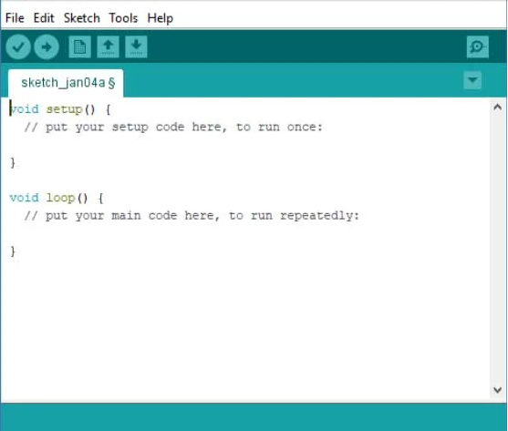
ARDUINO IDE SETUP

Slide 22
EMBEDDED C
Embedded C is most popular programming language in software field for developing electronic gadgets. Each processor used in electronic system is associated with embedded software.
Embedded C programming plays a key role in performing specific function by the processor. In day-to-day life we used many electronic devices such as mobile phone, washing machine, digital camera, etc.
These all device working is based on microcontroller that are programmed by embedded C.

Slide 23
CONT.,
The Embedded C code written in above block diagram is used for blinking the LED connected with Port0 of microcontroller.
In embedded system programming C code is preferred over other language. Due to the following reasons:
Easy to understand
High Reliability
Portability
Scalability
Function is a collection of statements that is used for performing a specific task and a collection of one or more functions is called a programming language.

Slide 24
CONT.,
Most consumers are familiar with application software that provide functionality on a computer.
Embedded software however is often less visible, but no less complicated.
Unlike application software, embedded software has fixed hardware requirements and capabilities, and addition of third-party hardware or software is strictly controlled.
Embedded software needs to include all needed device drivers at manufacturing time, and the device drivers are written for the specific hardware.
The software is highly dependent on the CPU and specific chips chosen.
Most embedded software engineers have at least a passing knowledge of reading schematics, and reading data sheets for components to determine usage of registers and communication system.
Conversion between decimal, hexadecimal and binary is useful as well as using bit manipulation.

